Slide 1

Trendspotting on Spotify
A look into what what generates success on Spotify
Group Members:
Atul Nulkar, Keith Horbin, Jasmine Orr, Justin McSpadden, Stone Powell

Slide 2

Motivations

Slide 3

Motivation & Research Questions
Explore some of the data points that enables Spotify to generate and curate their most Popular Playlists.
Analyze Spotify’s publicly available Playlists and Songs across different Genres of music to understand the different Audio Features and determine relationships and trends driving their Popularity.
Which Genres are more popular than others? Statistically, are there significant differences in Popularity between Genres?
Does the Duration of a song affect it’s Position within a playlist?
Does the Position of a song in a playlist impact it’s Popularity?
How are popular songs trending in terms of their Valence, i.e. songs that sound more positive (e.g. happy, cheerful, euphoric), vs songs that sound more negative (e.g. sad, depressed, angry)? Is there any correlation between the Speechiness and the Valence of a song?
How do various Audio Features of a Song - such as it's Danceability and Energy - influence it’s Popularity?

Slide 4
Data Exploration & Cleanup
Create Spotify App Integration
Encode API Credentials
Obtain Spotify Access Token
Retrieve Tracks within each Playlist using Spotify’s web API
Store & Merge to a clean DataFrame for Analysis
Identify 5 Popular Spotify Playlists across 12 Genres
Retrieve Audio Features of each Track using Spotify’s Web API
Multi-step, complex authentication flow to retrieve web API data that involves:
Spotify authorizing your Python app to access their Platform (APIs)
Spotify granting your Python app permission to access their curated playlists
Relatively clean dataset with minimal massaging required
Only sourced publicly available Playlists (created/curated by Spotify)
Limited data collection to Audio tracks
Found and resolved exceptions for Video tracks
Finding a needle in the haystack = heavy debugging
1 out of 4000+ sampled songs did not have any audio feature data
Variety > Quantity
Helped prevent API Rate Limit issues
Not required to refresh Access Token every hour
Track Position/Rank
Track Name
Popularity Score
Duration
Added At Date/Time
Album & Album Type
Artists
Release Date
Available Markets
Key
Mode
Time Signature
Acousticness
Danceability
Energy
Instrumentalness
Liveness
Loudness
Speechiness
Valence
Tempo

Slide 5
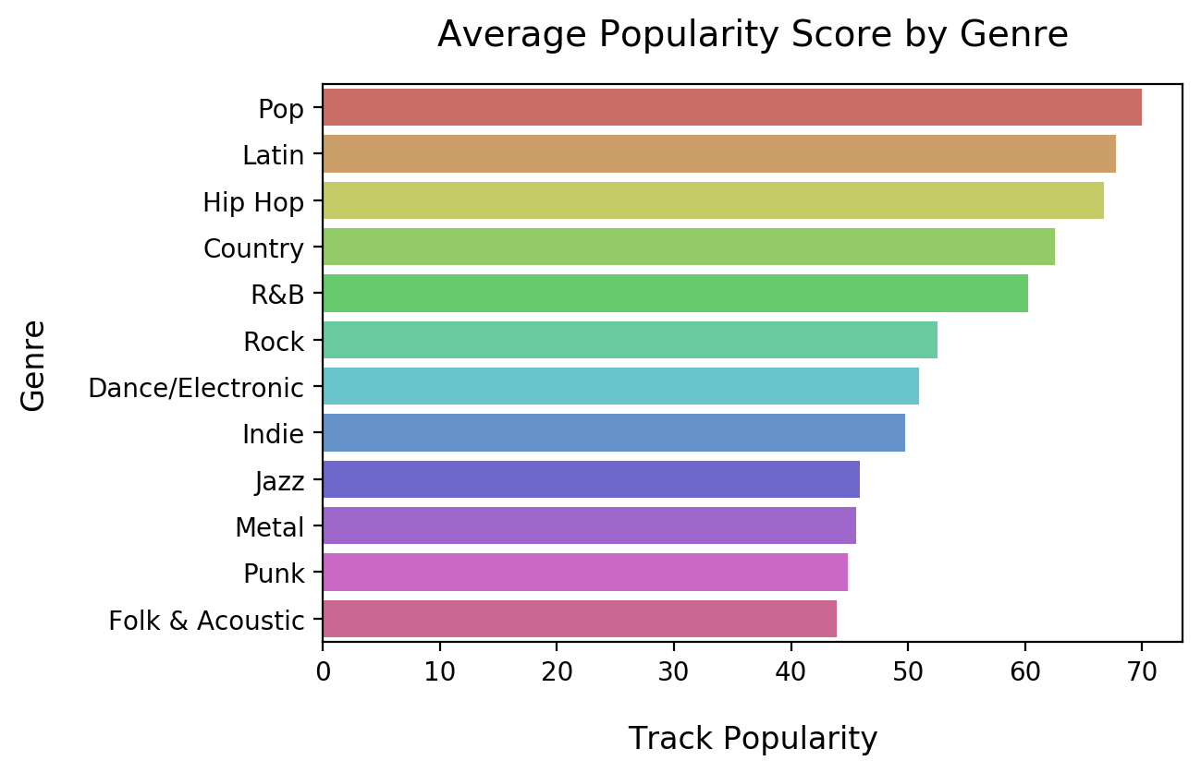
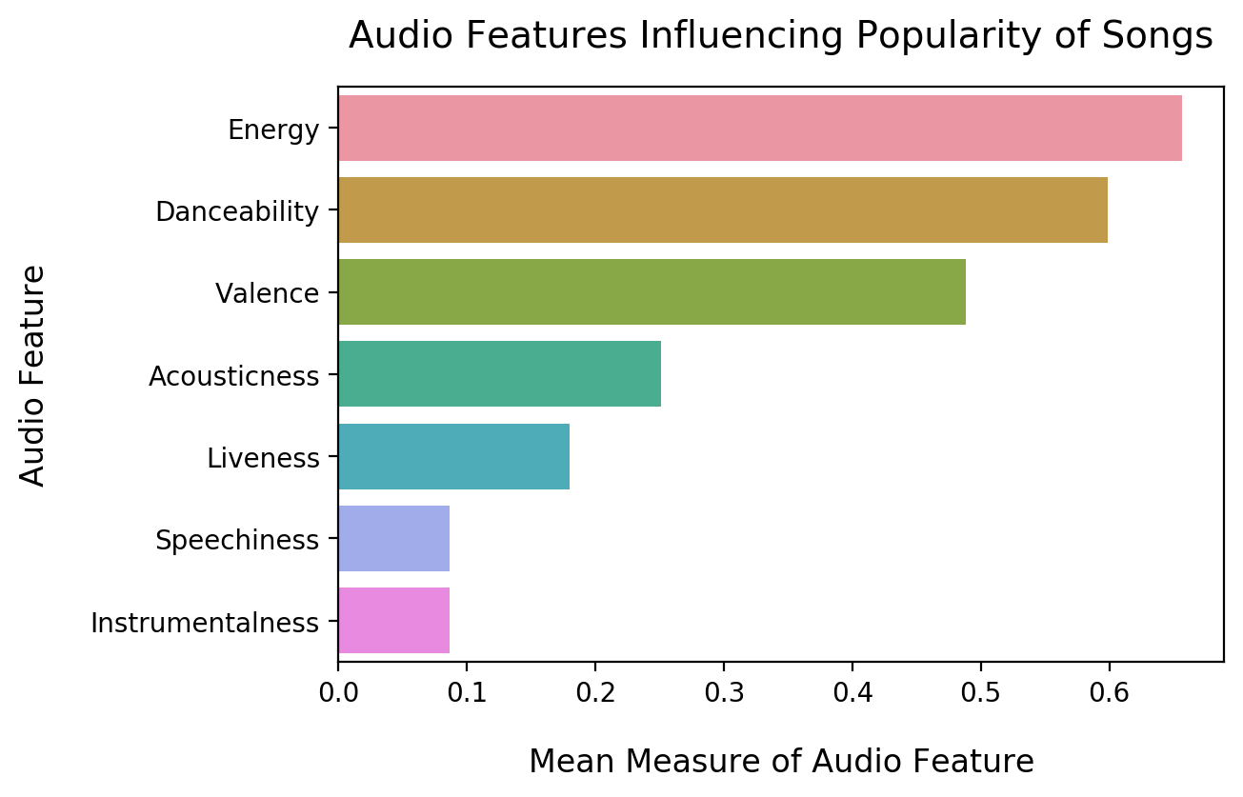
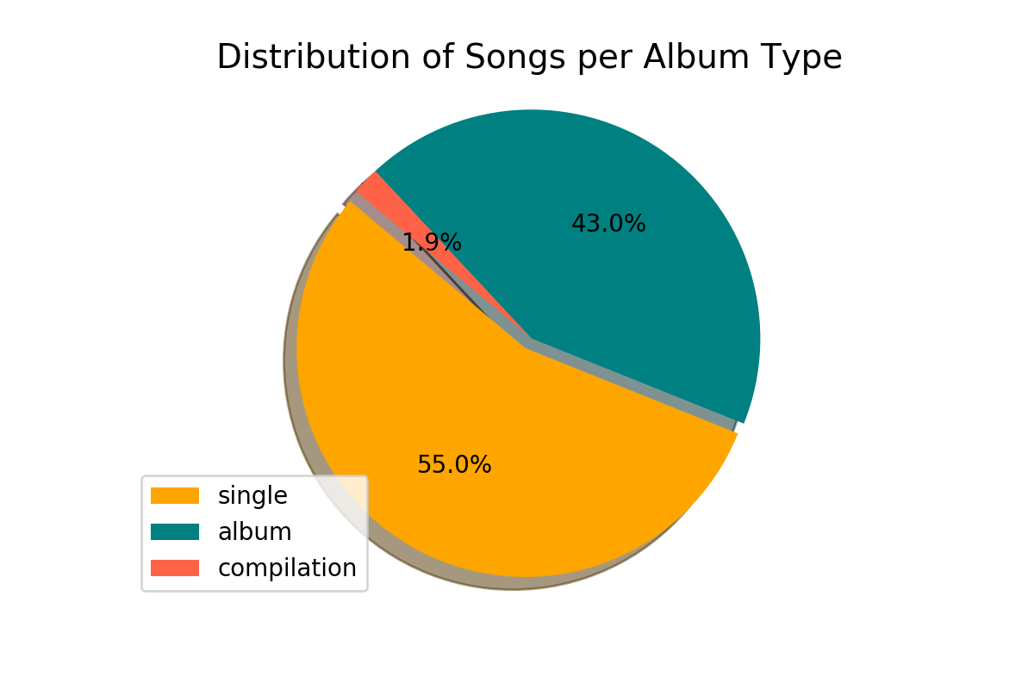
Summary Stats
The popularity of a track is a value between 0 and 100, with 100 being the most popular. Popularity is calculated by Spotify using an algorithm and is based, in the most part, on the total number of plays the track has had and how recent those plays are. Generally speaking, songs that are being played a lot now will have a higher popularity than songs that were played a lot in the past.
12 Genres
60 Playlists
3252 Unique Artists
4428 Songs
9 Audio Features Per Track

Slide 6
Audio Features Overview
Instrumentalness: This value represents the amount of vocals in the song. The closer it is to 1.0, the more instrumental the song is.
Acousticness: This value describes how acoustic a song is. A score of 1.0 means the song is most likely to be an acoustic one.
Liveness: This value describes the probability that the song was recorded with a live audience. According to the official documentation “a value above 0.8 provides strong likelihood that the track is live”.
Speechiness: “Speechiness detects the presence of spoken words in a track”. If the speechiness of a song is above 0.66, it is probably made of spoken words, a score between 0.33 and 0.66 is a song that may contain both music and words, and a score below 0.33 means the song does not have any speech.
Energy: “(energy) represents a perceptual measure of intensity and activity. Typically, energetic tracks feel fast, loud, and noisy”.
Danceability: “Danceability describes how suitable a track is for dancing based on a combination of musical elements including tempo, rhythm stability, beat strength, and overall regularity. A value of 0.0 is least danceable and 1.0 is most danceable”.
Valence: “A measure from 0.0 to 1.0 describing the musical positiveness conveyed by a track. Tracks with high valence sound more positive (e.g. happy, cheerful, euphoric), while tracks with low valence sound more negative (e.g. sad, depressed, angry)”.

Slide 7
Questions

Slide 8
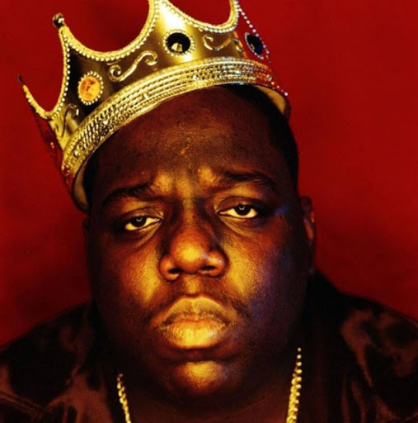

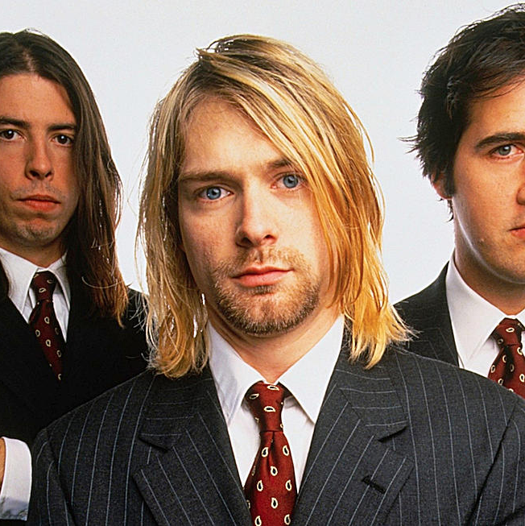
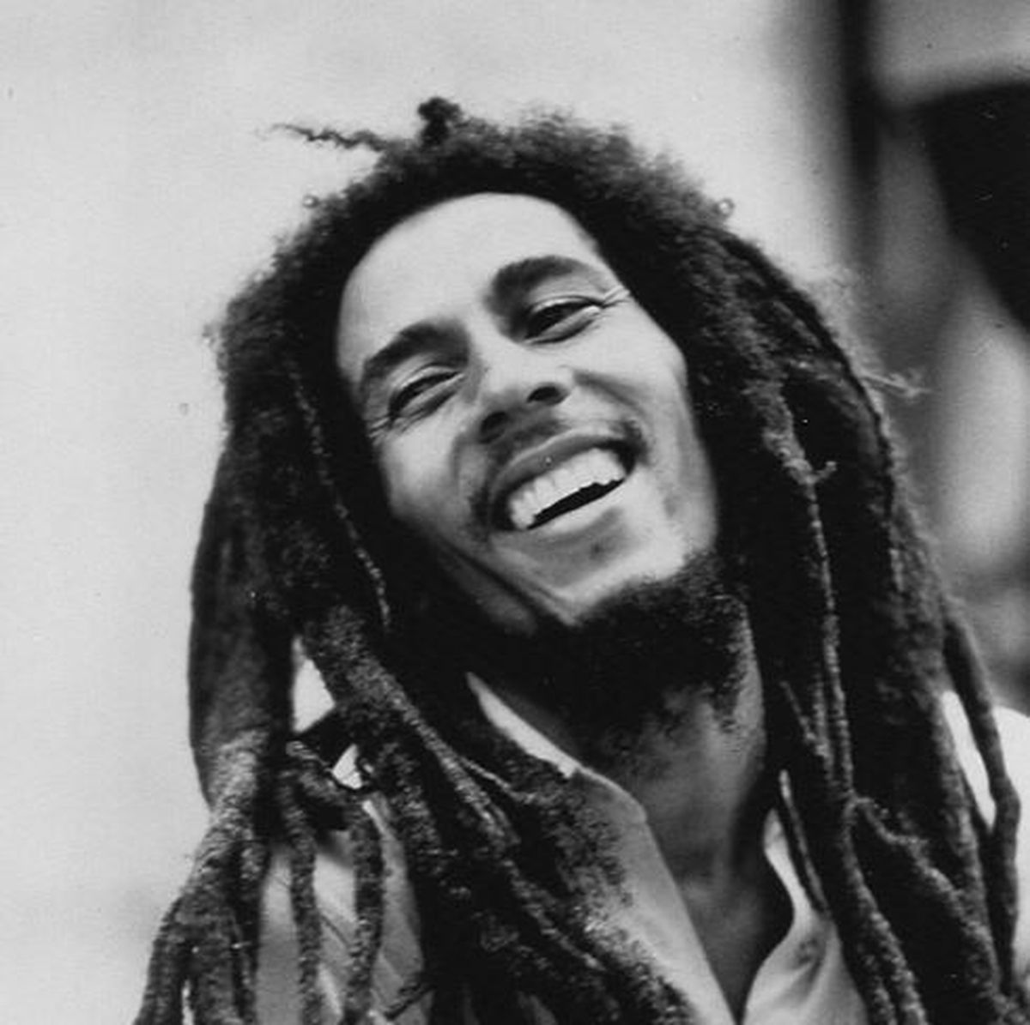
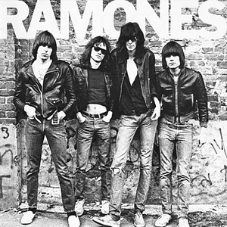
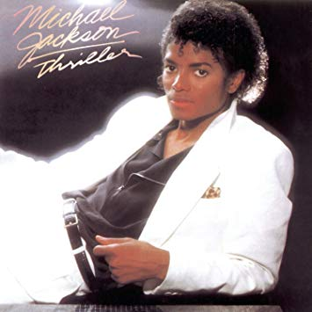
Question 1
Which genres are the most popular?
Conducted analysis to determine if there is a statistically significant difference in popularity across genres
Grouped all data by genre
Performed ANOVA
Picked genres to use for T-tests
1
2
3
4
5
6

Slide 9
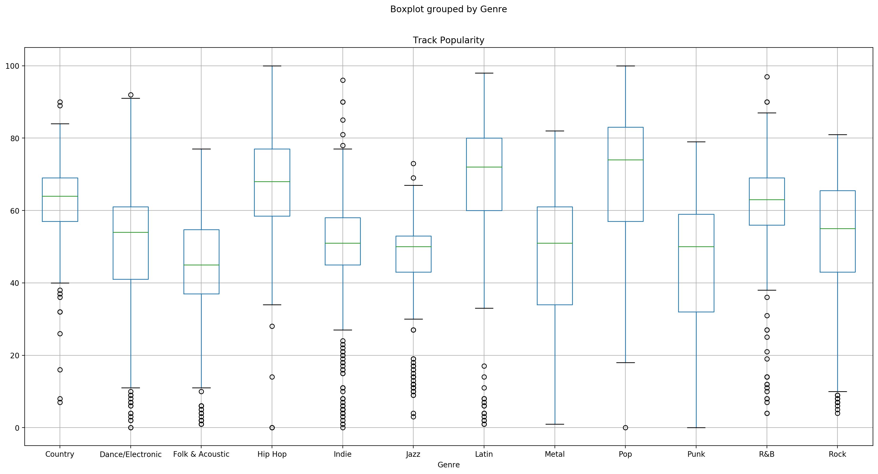
ANOVA Box plot
P-value: 1.5301e-250
Hip Hop vs Folk & Acoustic resulted in p-value of 7.4238e-77
Jazz vs Latin resulted in p-value of 3.6588e-62

Slide 10
Question 2
Does duration of a song affect its position in a playlist?
Do shorter songs typically have better (lower) track positions?
1
2
3
4
5
6

Slide 11
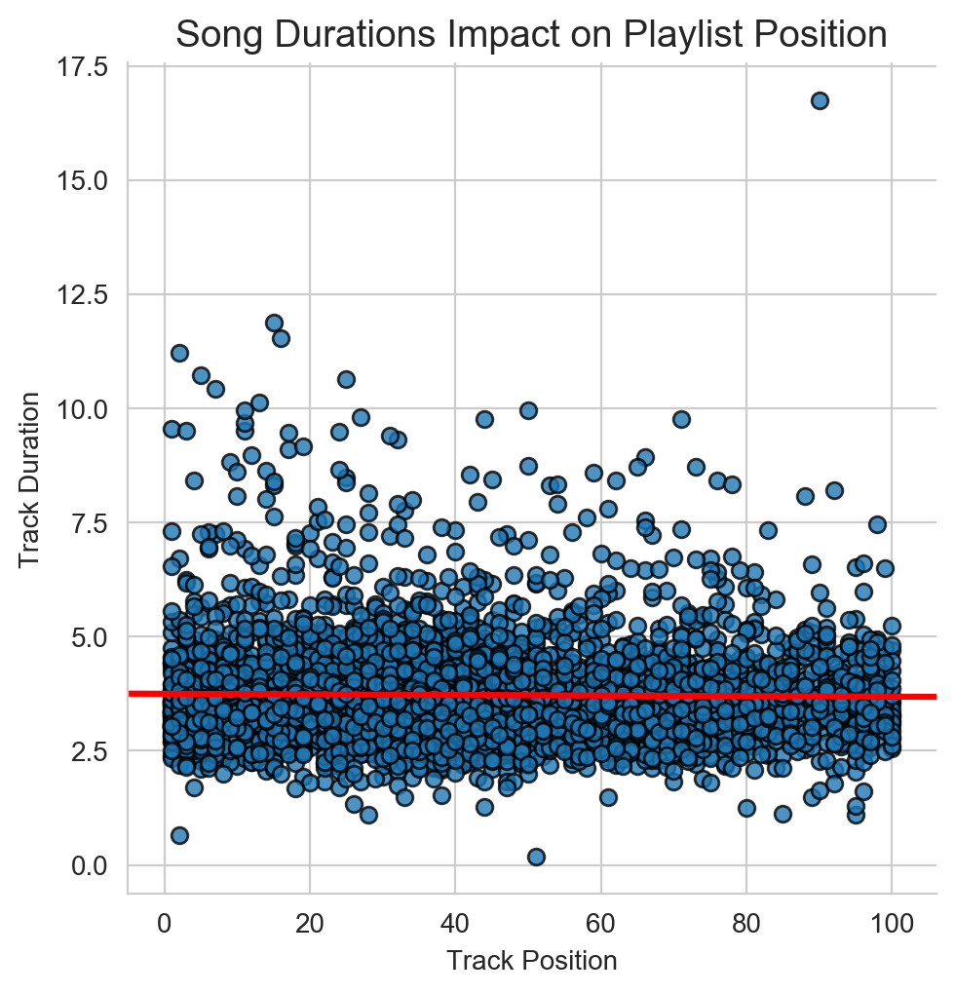
Duration has no impact on track position in this study
Worth noting that despite the surge in streaming as the means to access music, music still generally follows the formula for radio friendly.

Slide 12
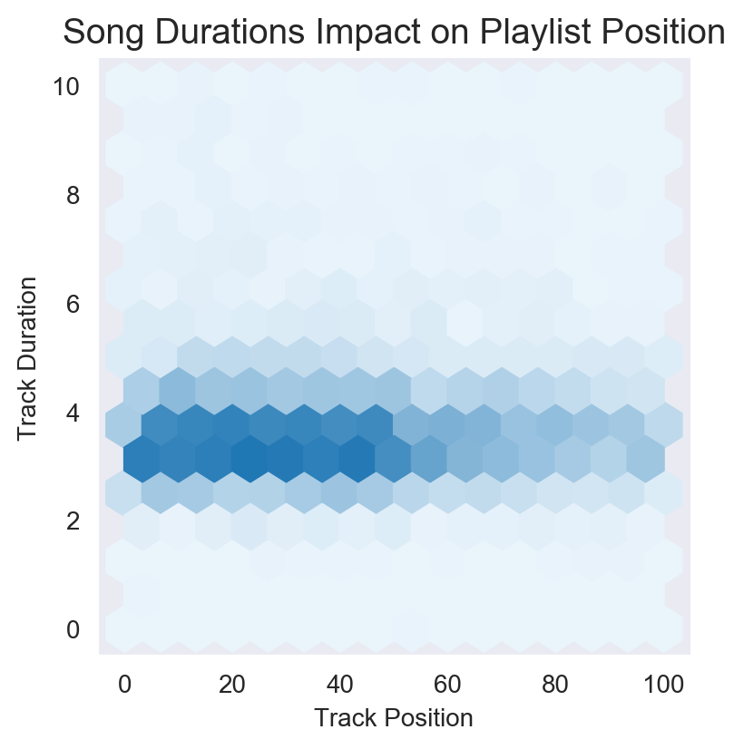

Slide 13
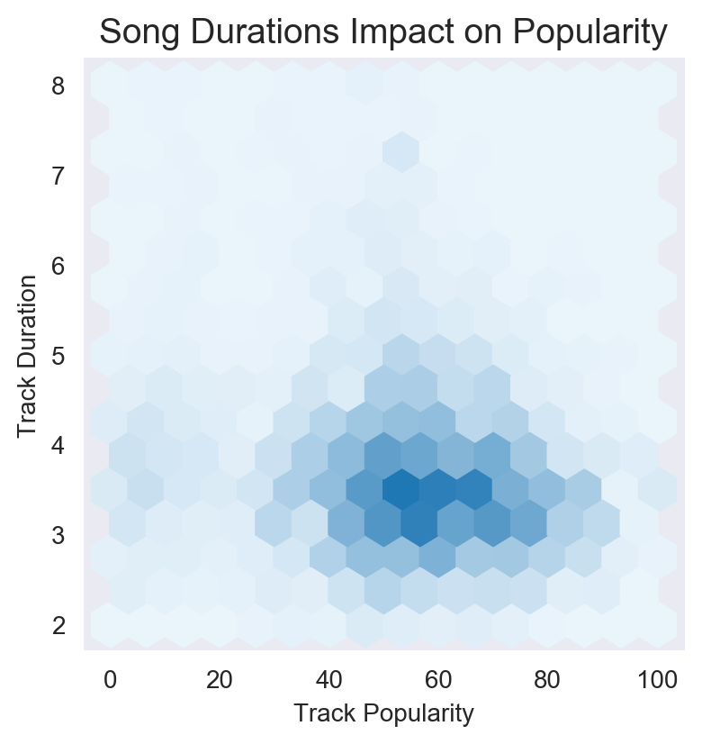

Slide 14
Question 3
Does the position of a song in a playlist impact it's popularity?
If a song is closer to the top of a playlist is it more popular?
How does the trend look for the sample set, genre, and playlist level?
1
2
3
4
5
6

Slide 15
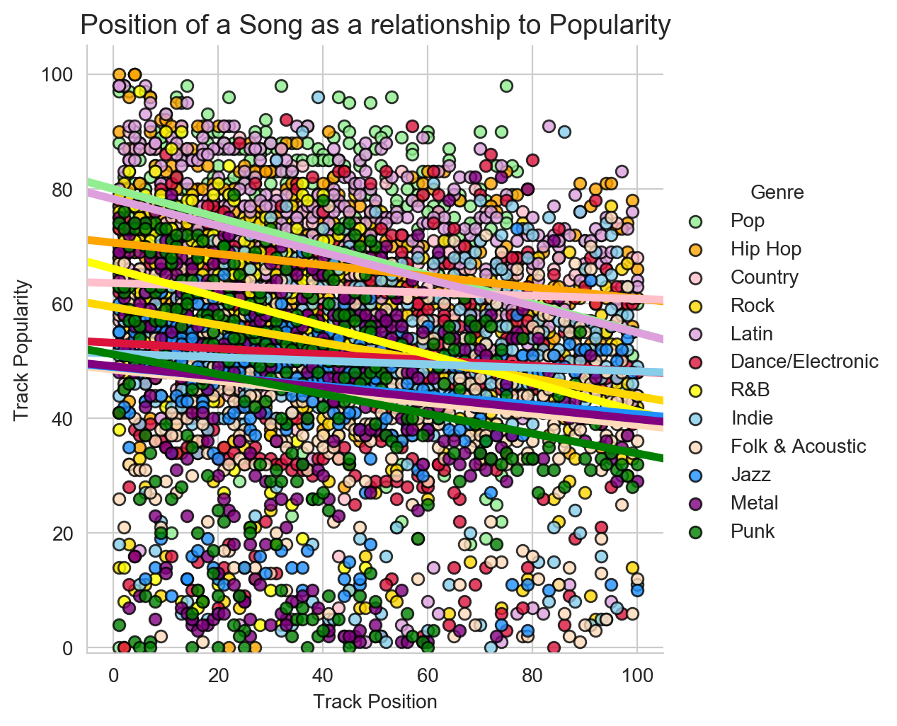
Universally all genres fit the pattern of a lower track position within a playlist aiding in increasing the popularity of the track.

Slide 16
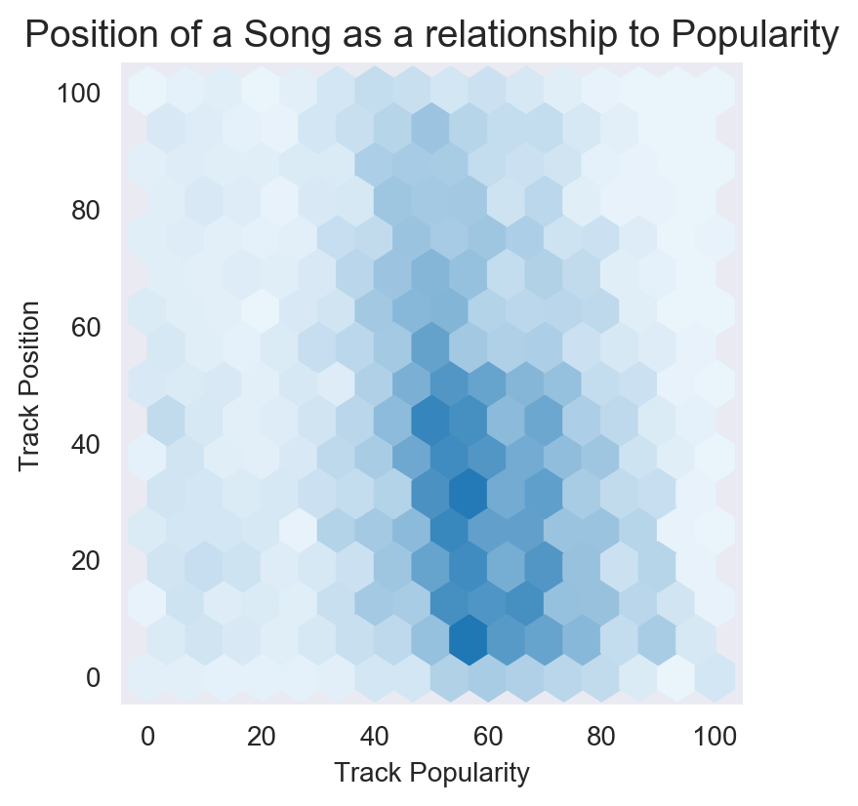
Density suggests that the better performing popularity rank holds to a track number of 40 or less.

Slide 17
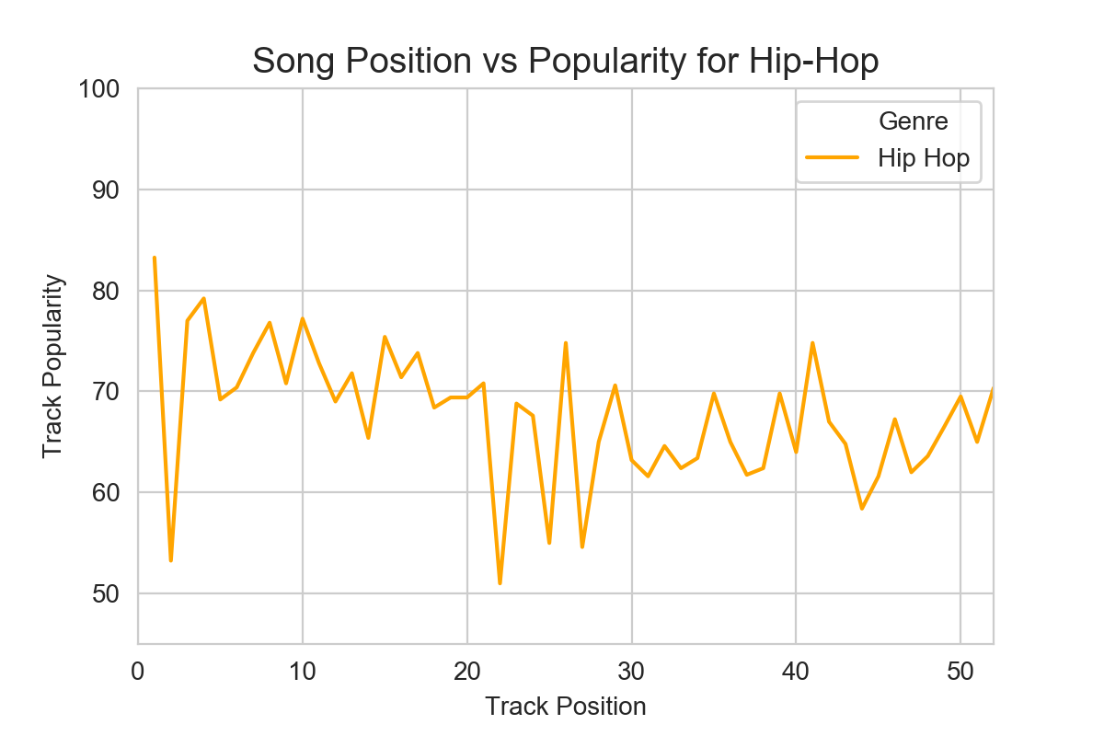

Slide 18
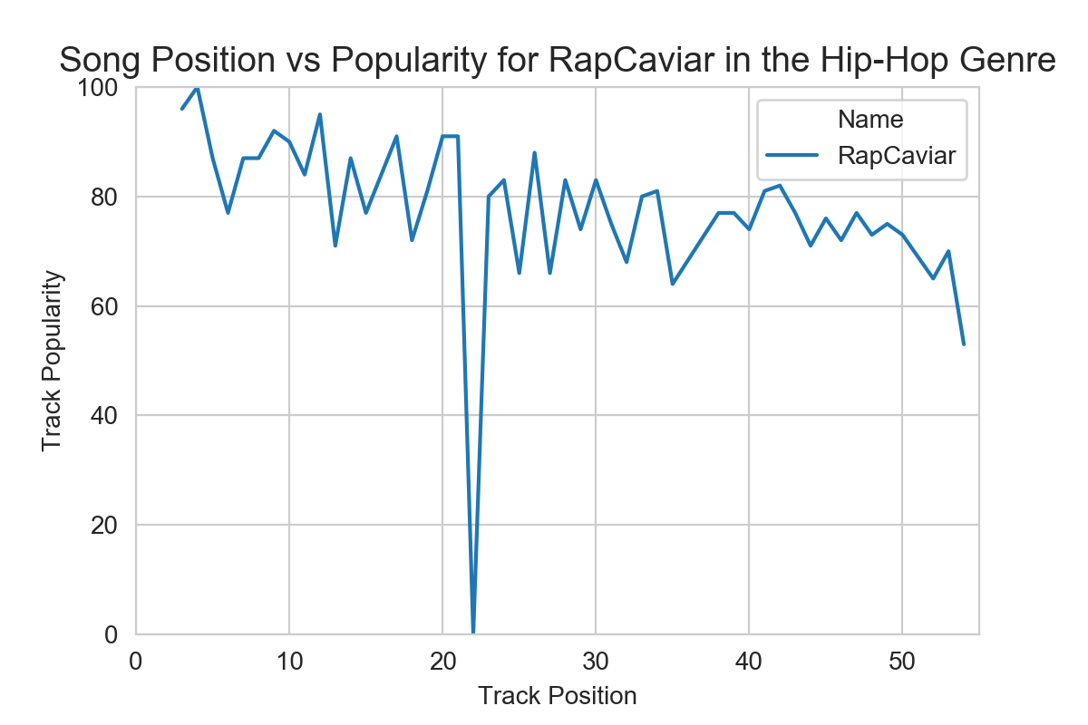

Slide 19
Question 4
How are popular songs trending in terms of their valence. Is there any correlation between the speechiness and the valence of a song?
How do songs that sound more positive (e.g. happy, cheerful, euphoric), do vs songs that sound more negative (e.g. sad, depressed, angry)?
Does speechiness trend more positively or negatively?
1
2
Speechiness: “Speechiness detects the presence of spoken words in a track”. If the speechiness of a song is above 0.66, it is probably made of spoken words, a score between 0.33 and 0.66 is a song that may contain both music and words, and a score below 0.33 means the song does not have any speech.
Valence: “A measure from 0.0 to 1.0 describing the musical positiveness conveyed by a track. Tracks with high valence sound more positive (e.g. happy, cheerful, euphoric), while tracks with low valence sound more negative (e.g. sad, depressed, angry)”.
3
4
5
6

Slide 20
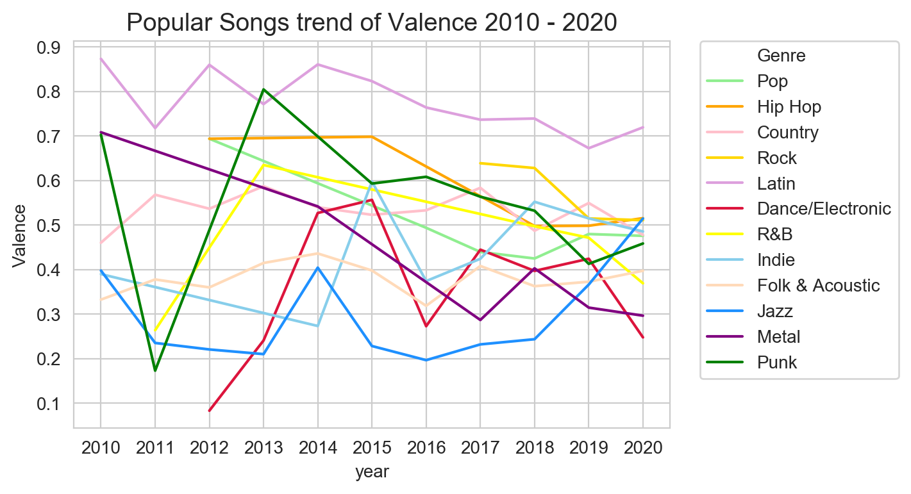
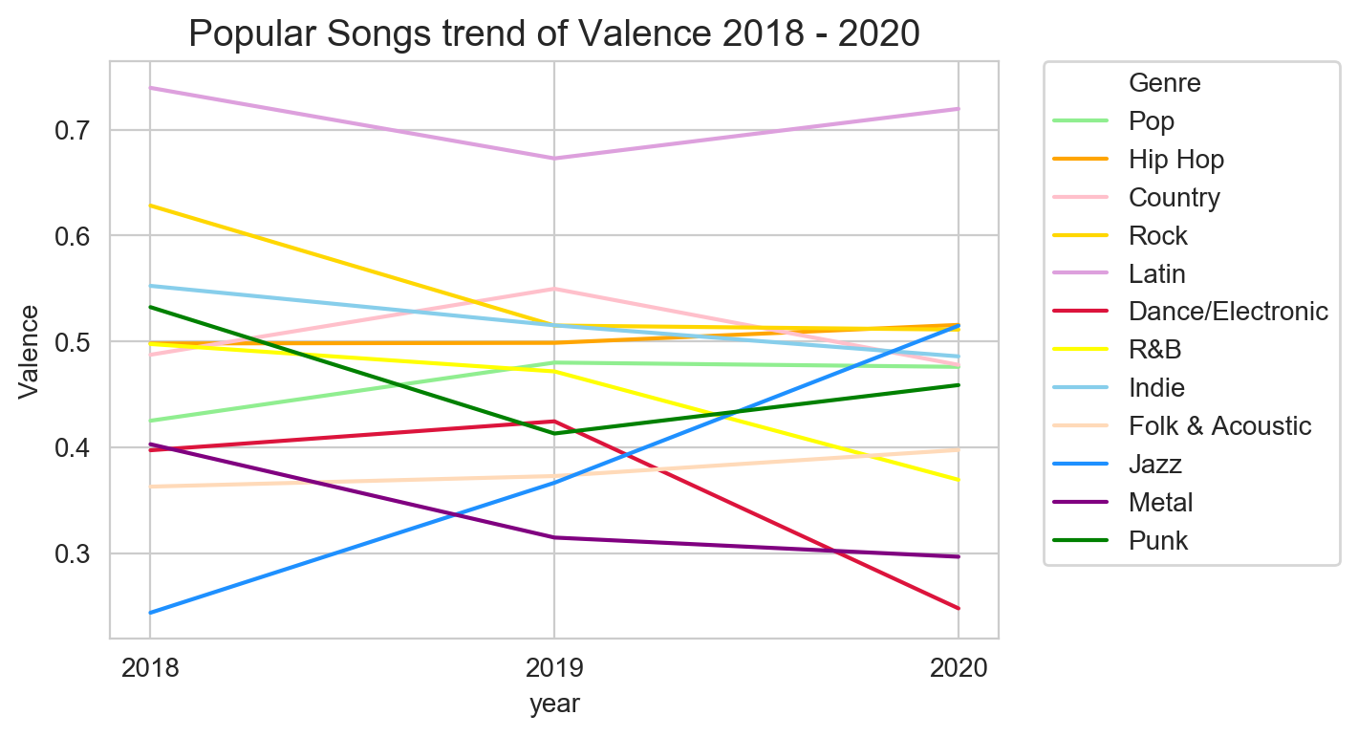
No common Valence trend for all genres.
Generally all genres have increasingly trended more negative over the past two years and at best have been flat. Jazz had the largest positive trend since 2018

Slide 21
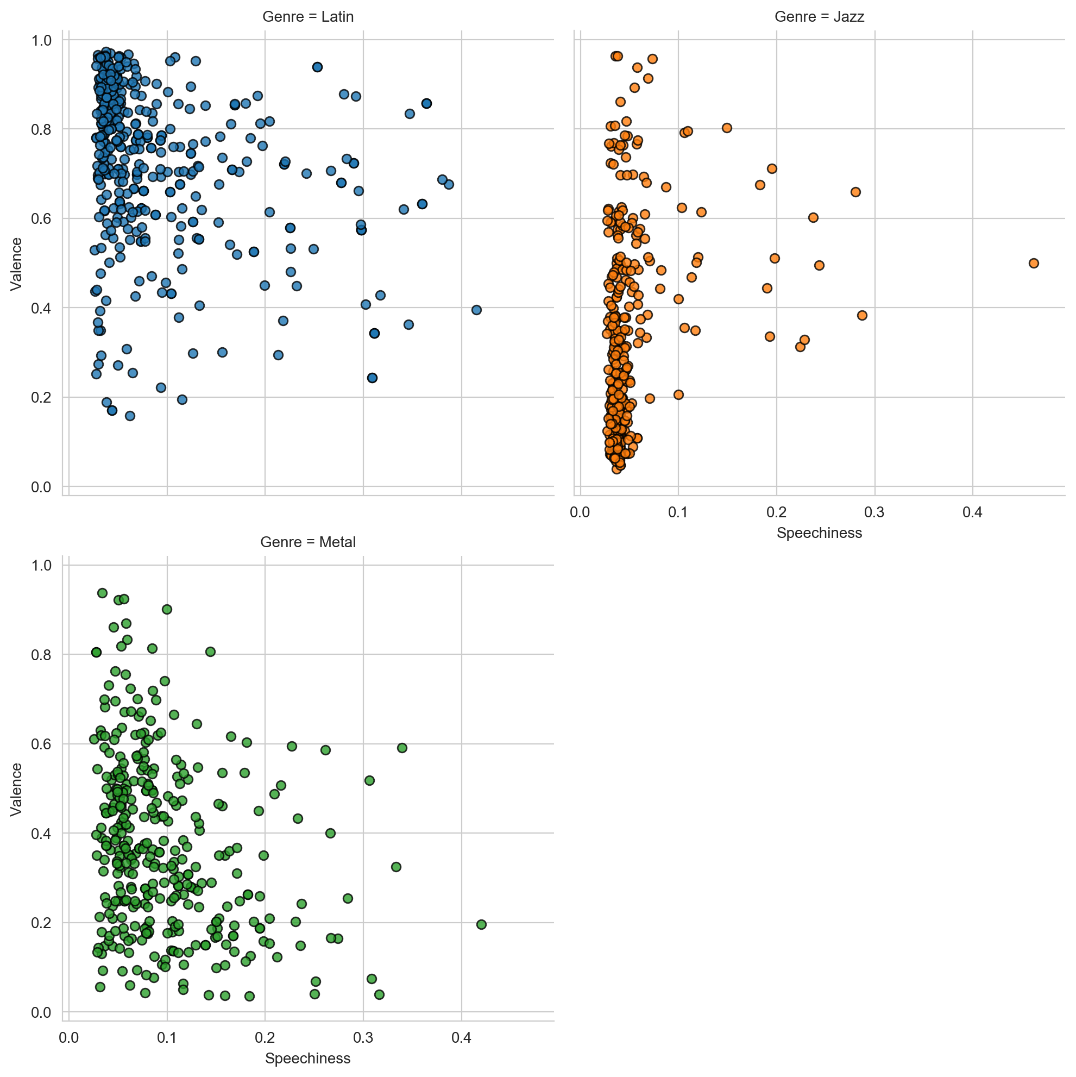
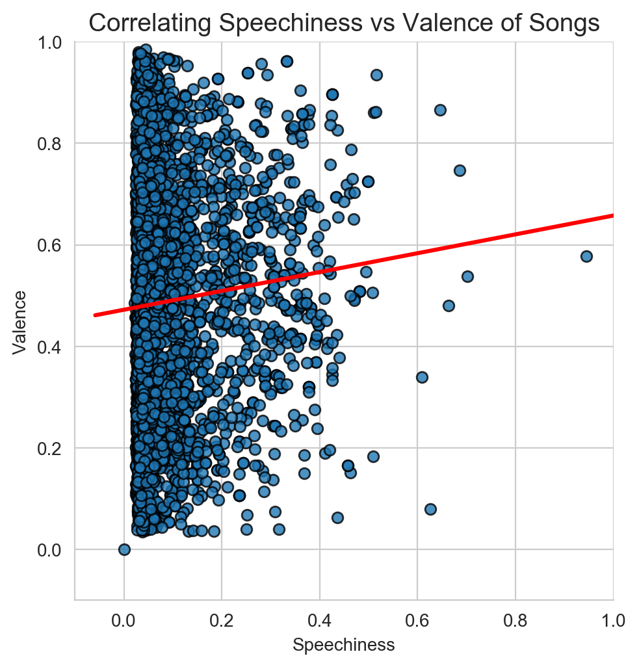
Valence Trends positively on the presence of increased words/lyrics across all genres
Sample of Latin illustrates the presence of lyrics and the content of them attributes to positivity
Sample of Metal illustrates the presence of lyrics and the content of them attributes to negativity
Sample of Jazz illustrates the absence of lyrics resulting in a negativity

Slide 22
Question 5
How do various Audio Features of a Song such as influence the popularity of Songs?
Are there certain ranges for audio features that cause a song to be more popular?
1
2
3
4
5
6

Slide 23
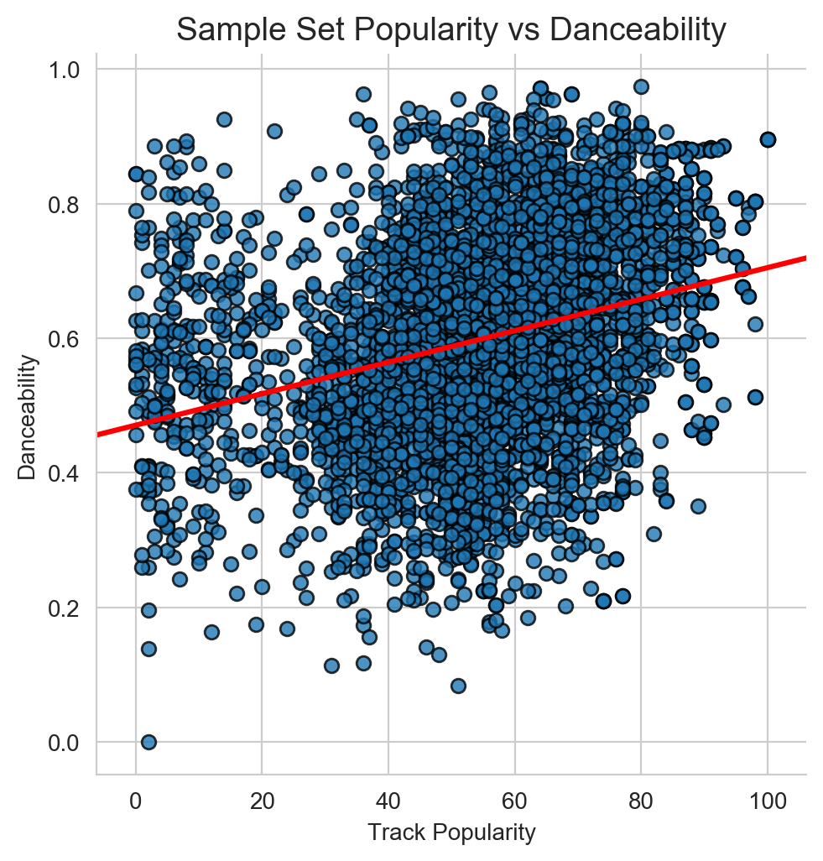
Danceability: “Danceability describes how suitable a track is for dancing based on a combination of musical elements including tempo, rhythm stability, beat strength, and overall regularity. A value of 0.0 is least danceable and 1.0 is most danceable”.

Slide 24
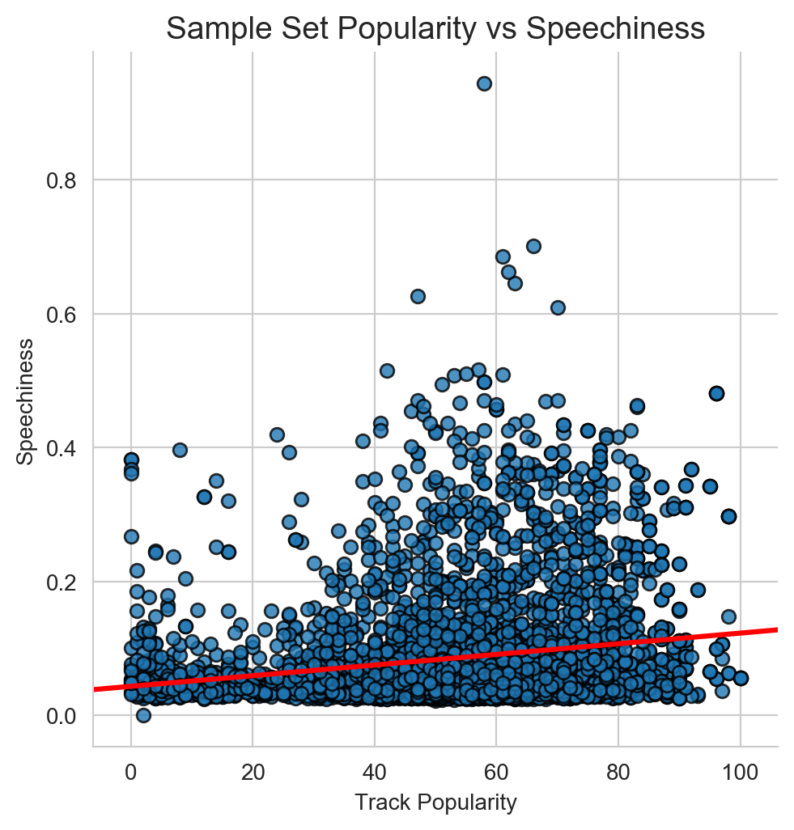
Speechiness: “Speechiness detects the presence of spoken words in a track”. If the speechiness of a song is above 0.66, it is probably made of spoken words, a score between 0.33 and 0.66 is a song that may contain both music and words, and a score below 0.33 means the song does not have any speech.

Slide 25
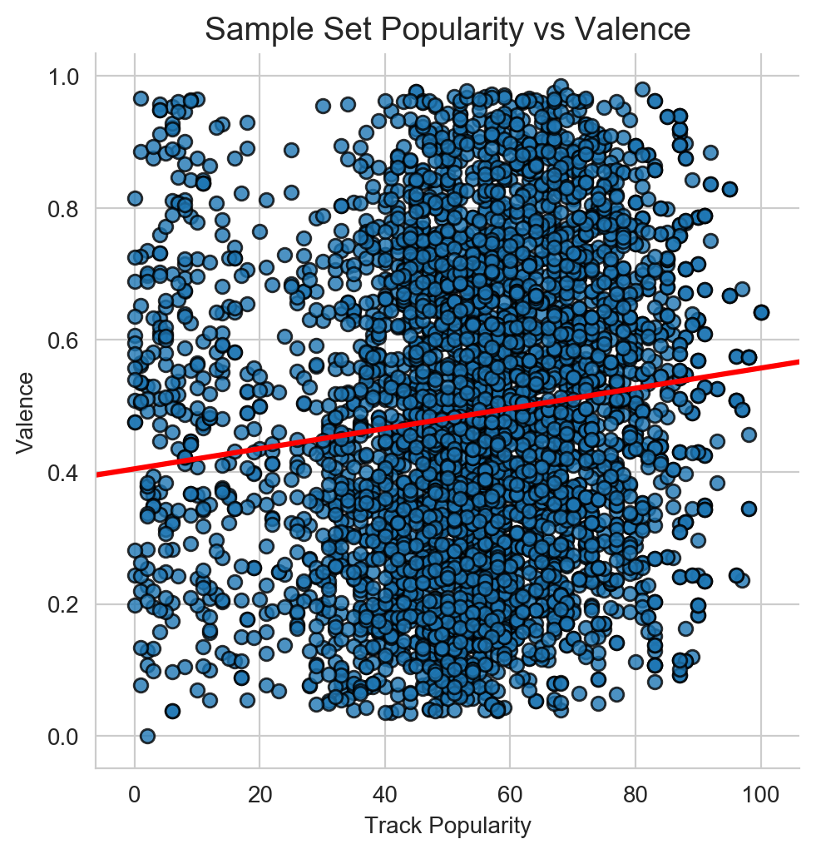
Valence: “A measure from 0.0 to 1.0 describing the musical positiveness conveyed by a track. Tracks with high valence sound more positive (e.g. happy, cheerful, euphoric), while tracks with low valence sound more negative (e.g. sad, depressed, angry)”.

Slide 26
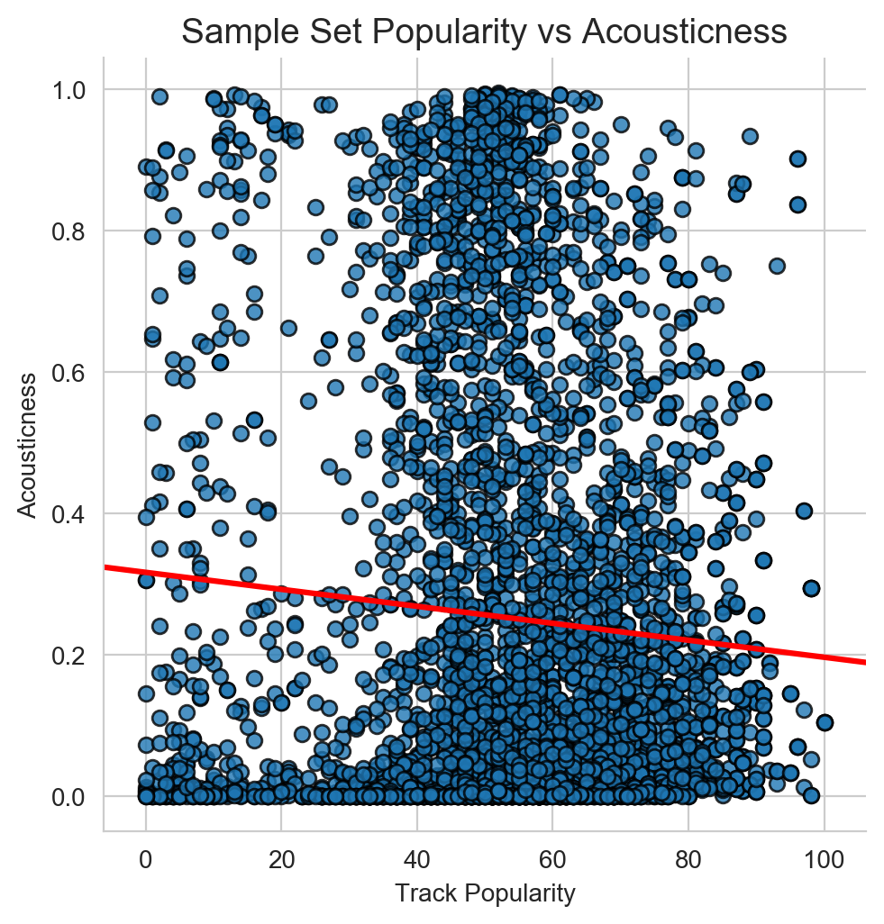
Acousticness: This value describes how acoustic a song is. A score of 1.0 means the song is most likely to be an acoustic one.

Slide 27
Post Mortem

Slide 28
Closing Remarks
Main takeaways
Key things that impact making it to a playlist and popularity.
Songs need to be in duration of 4 minutes or less
Ideally in a track position of 40 or less in a playlist
Great dancability: ideally .6 or higher
Right amount of speechiness: 0.1- 0.2
Valence must be ideally greater than 0.6
Difficulties:
Handling Git Bash
Challenges dealing with API data. We initially looked at tracking popularity over time, but we had to change our research based off what we could get from the API.
What we would research next:
How to make a perfect track. Would leverage Spotify API for audio analysis.
Would take a more detailed look into valence. Look at valence over speechiness over the last 10 years and see if there was a trend.
Set up the Spotify API to call every 6 hours and analyze how spotify updates playlists. How they move track positions, how they decided what songs to add or take away, and how this impacts popularity.

Slide 29

Any Questions?

Slide 30
Appendix

Slide 31
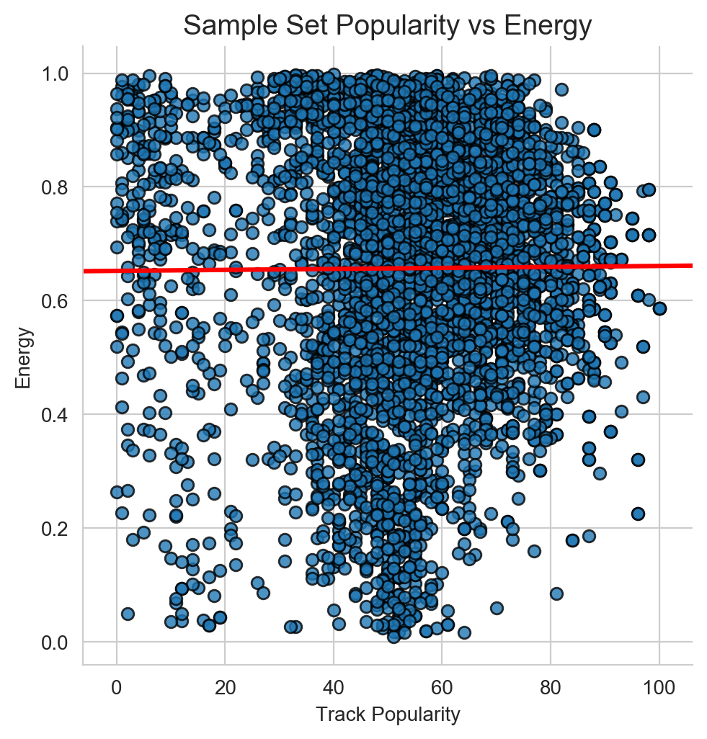
Energy: “(energy) represents a perceptual measure of intensity and activity. Typically, energetic tracks feel fast, loud, and noisy”

Slide 32
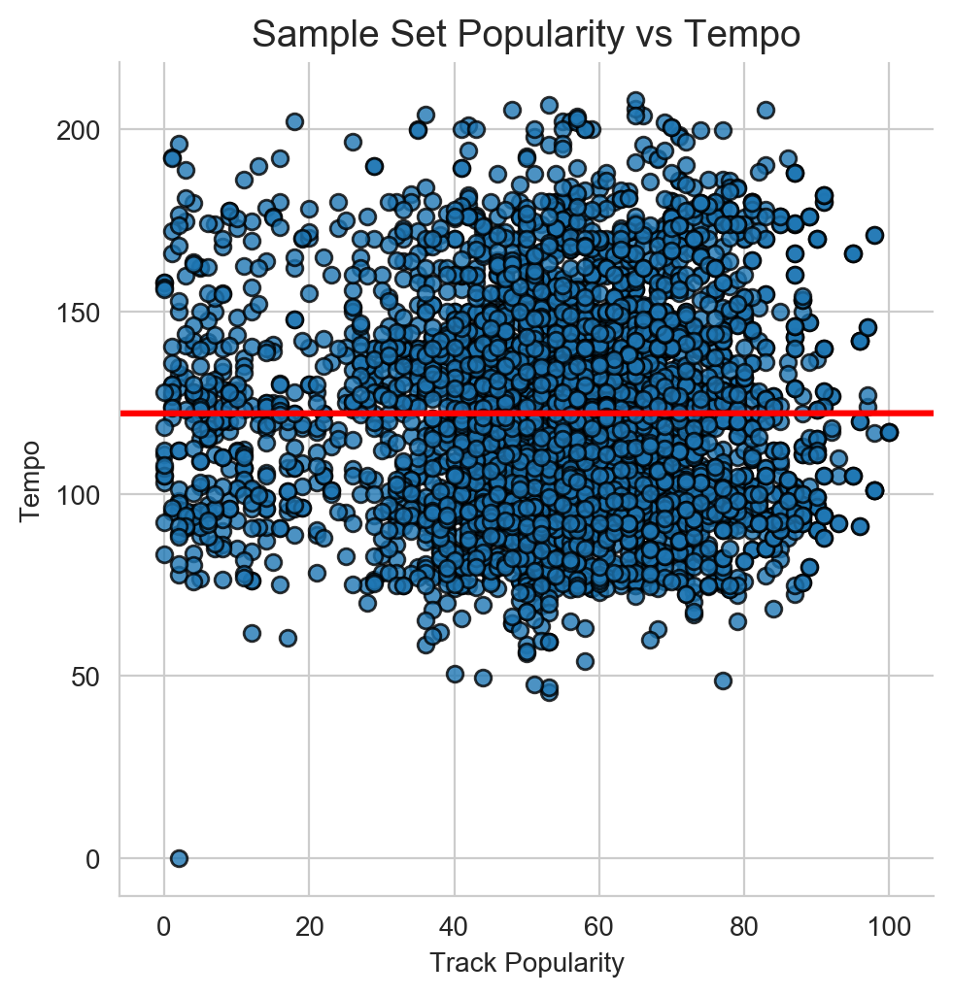
Tempo: The overall estimated tempo of a track in beats per minute (BPM). In musical terminology, tempo is the speed or pace of a given piece and derives directly from the average beat duration. The distribution of values for this feature look like this:

Slide 33
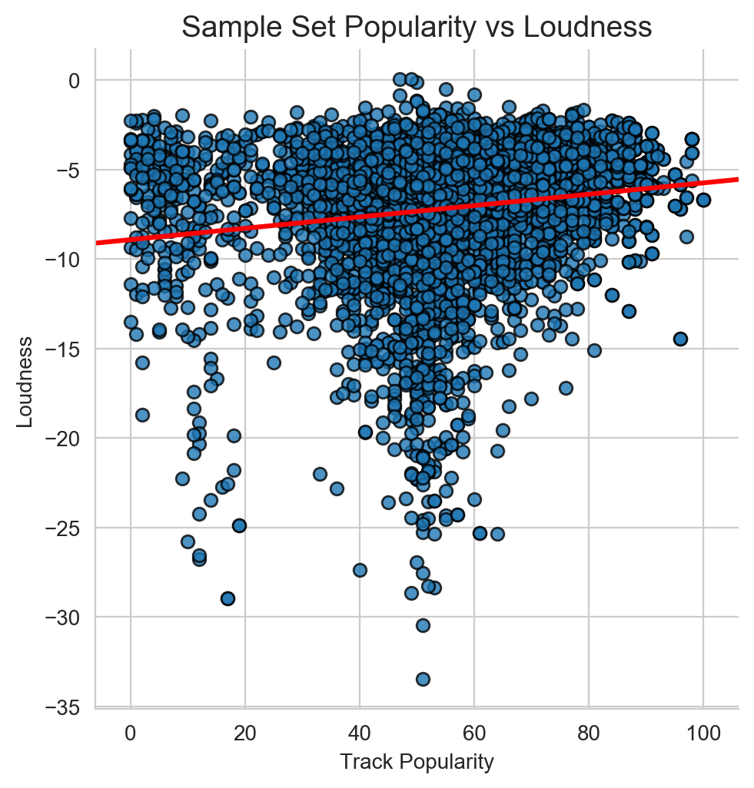
Loudness: The overall loudness of a track in decibels (dB). Loudness values are averaged across the entire track and are useful for comparing relative loudness of tracks. Loudness is the quality of a sound that is the primary psychological correlate of physical strength (amplitude)

Slide 34
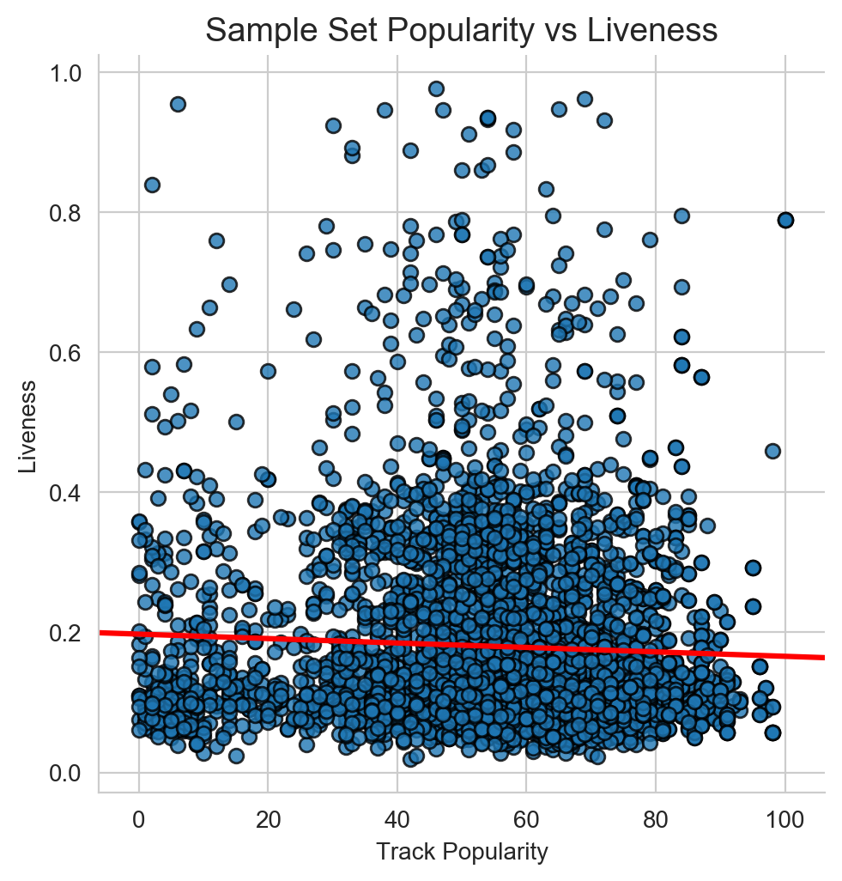
Liveness: This value describes the probability that the song was recorded with a live audience. According to the official documentation “a value above 0.8 provides strong likelihood that the track is live”.

Slide 35
Audio Features Overview
Instrumentalness: This value represents the amount of vocals in the song. The closer it is to 1.0, the more instrumental the song is.
Acousticness: This value describes how acoustic a song is. A score of 1.0 means the song is most likely to be an acoustic one.
Liveness: This value describes the probability that the song was recorded with a live audience. According to the official documentation “a value above 0.8 provides strong likelihood that the track is live”.
Speechiness: “Speechiness detects the presence of spoken words in a track”. If the speechiness of a song is above 0.66, it is probably made of spoken words, a score between 0.33 and 0.66 is a song that may contain both music and words, and a score below 0.33 means the song does not have any speech.
Energy: “(energy) represents a perceptual measure of intensity and activity. Typically, energetic tracks feel fast, loud, and noisy”.
Danceability: “Danceability describes how suitable a track is for dancing based on a combination of musical elements including tempo, rhythm stability, beat strength, and overall regularity. A value of 0.0 is least danceable and 1.0 is most danceable”.
Valence: “A measure from 0.0 to 1.0 describing the musical positiveness conveyed by a track. Tracks with high valence sound more positive (e.g. happy, cheerful, euphoric), while tracks with low valence sound more negative (e.g. sad, depressed, angry)”.

